Slide 1
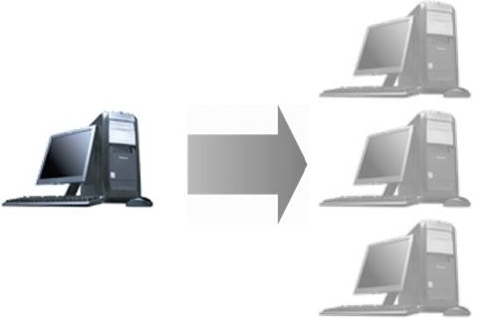
Server Virtualization
.

Slide 2

Overview
Why Virtualize?
Server Virtualization Concepts
Virtualization Products
A Sample of Virtualization Products
Open Virtualization Format (OVF)
Note: Storage Virtualization and Network Virtualization will be discussed in subsequent lectures

Slide 3
Virtualization
“Virtualization means that Applications can use a resource without any concern for where it resides, what the technical interface is, how it has been implemented, which platform it uses, and how much of it is available.”
-Rick F. Van der Lans
in Data Virtualization for Business Intelligence Systems

Slide 4

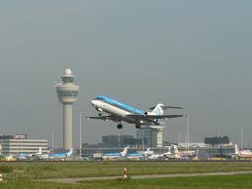

5 Reasons to Virtualize
Sharing: Break up a large resource Large Capacity or high-speed E.g., Servers
Isolation: Protection from other tenants E.g., Virtual Private Network
Aggregating: Combine many resources in to one, e.g., storage
Dynamics: Fast allocation, Change/Mobility, load balancing, e.g., virtual machines
Ease of Management ⇒ Easy distribution, deployment, testing
10Gb
Switch
Switch
Switch
Switch

Slide 5
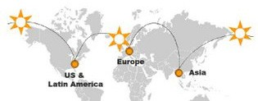
Advantages of Virtualization
Minimize hardware costs (CapEx)
Multiple virtual servers on one physical hardware
Easily move VMs to other data centers
Provide disaster recovery. Hardware maintenance.
Follow the sun (active users) or follow the moon (cheap power)
Consolidate idle workloads. Usage is bursty and asynchronous. Increase device utilization
Conserve power
Free up unused physical resources
Easier automation (Lower OpEx)
Simplified provisioning/administration of hardware and software
Scalability and Flexibility: Multiple operating systems

Slide 6
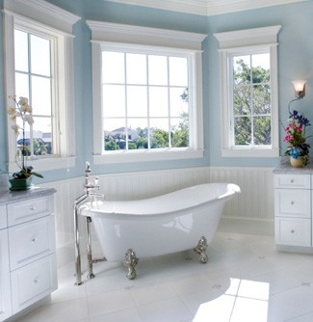
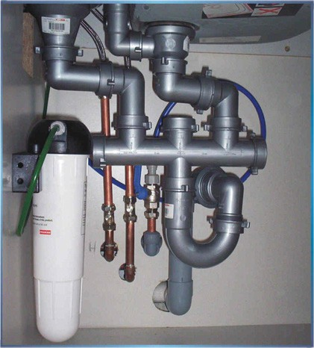
Virtualization in Computing
Storage:
Virtual Memory ⇒ L1, L2, L3, ... ⇒ Recursive
Virtual CDs, Virtual Disks (RAID), Cloud storage
Computing:
Virtual Desktop ⇒ Virtual Server ⇒ Virtual Datacenter
Thin Client ⇒ VMs ⇒
Networking: Plumbing of computing
Virtual Channels, Virtual LANs, Virtual Private Networks
Cloud

Slide 7
Server Virtualization Concepts
Guest OS₁ | … | Guest OS_{n}
Hypervisor Type 2
Host OS
Hardware
Guest OS₁ | … | Guest OS_{n}
Hypervisor Type 1
Hardware
Host OS: Runs on the bare metal
Guest OS: Runs on the host OS, e.g., Windows XP Mode on Win 7
Hypervisor: Software to support multiple virtual machines
Type 1: Runs on bare metal, e.g., Xen, VMware ESXi
Type 2: Runs on a host OS, e.g., MS Virtual PC
Type 0: Both 1 and 2, e.g., Linux KVM

Slide 8
Levels of Virtualization
User Virtualization
Application Virtualization
Desktop
Service Virtualization
Operating System Virtualization
Server Virtualization
Storage Virtualization
Network Virtualization
Network and Storage virtualization will be discussed in later modules of this course.

Slide 9
Operating System-Level Virtualization
Container
Container
Container
Operating System
Multiple isolated user spaces on the same operating system
Example: Windows Server 2003, 2008, 2012,2019 …
Multiple users can remotely login and use the system. Only one operating system instance
Guest operating system is similar or same as the host, E.g., Windows on Windows
Applications of one user cannot affect other users aka Jails => Can be used to run suspect software E.g., iCore Virtual Accounts and Sandboxie

Slide 10
Desktop Virtualization
A Desktop system with multiple operating systems
Example: Mac OS X and Windows at the same time Parallels Desktop for Mac
Hypervisor type 1 similar to server virtualization
Useful for testing software on multiple OS
Reduced hardware cost
This is local desktop virtualization
Guest OS₁ | … | Guest OS_{n}
Hypervisor Type 1
Hardware

Slide 11
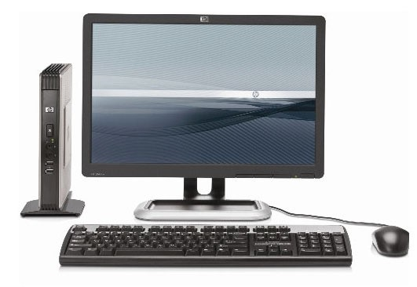
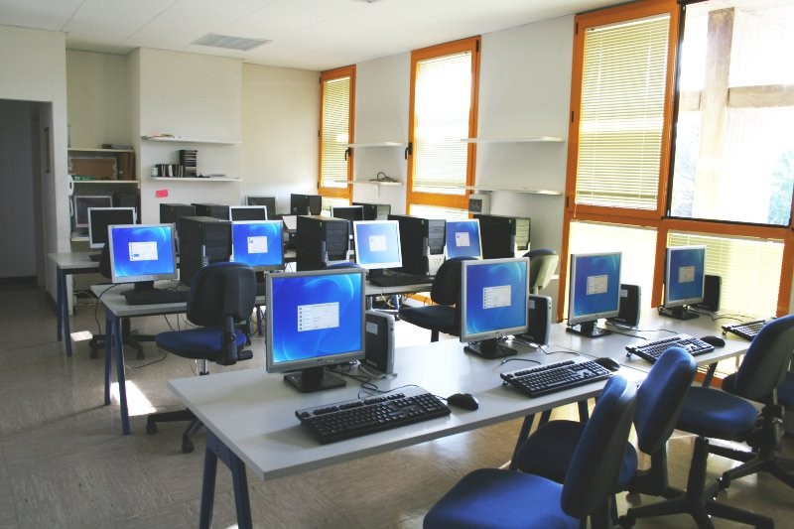
Thin Client
Also called Remote Desktop Virtualization or Virtual Desktop Infrastructure (VDI)
or Access Virtualization
Remote server provides most of the computing and storage resources
All programs and data is stored on remote servers
Local computer is simple with limited resources
Easy maintenance and upgrades
Users can log in on any client
Significant energy savings
Example: Chrome books
Zero Client: Power cable only. USB and communication via WiFi

Slide 12
Application Virtualization
Allows an application to run on many different operating systems and hardware
Application byte code can run on different processors and operating systems usually using an interpreter or just-in-time (run-time) compilation
Examples: Java Virtual Machine (JVM)
12

Slide 13



Service Virtualization
Service is similar to but different from applications in that they are hidden from the end user
Example services: Firewall, load balancer, Proxy Server
Service virtualization: Virtual appliances implemented in software
A load balancer’s IP address is advertised outside. It distributes the load to multiple servers.
Load Balancer
…

Slide 14
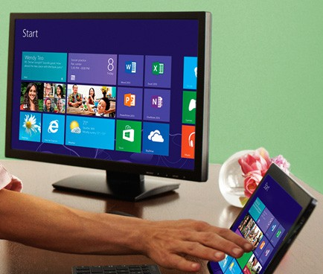
User Experience Virtualization
Aka User Virtualization
Users see the same application interface regardless of the device: laptop, tablet, Smart Phone
Users can roam from device to device
User profiles and application settings are stored in a central data center or cloud
Example: Microsoft UE-V

Slide 15
Related Concepts
Hardware Emulation
Hardware Assisted Virtualization
Parallel Virtual Machines
Paravirtualization

Slide 16
Hardware Emulation
Mimic a different type of hardware, e.g., SPARC on PC
Examples:
Microsoft Virtual PC for Mac: x86 on PowerPC
Bochs (pronounced Box): emulates x86 on UNIX, Linux, Windows, and Mac OS X
QEMU: Emulates x86, x86₆₄, ARM, SPARC, PowerPC, MIPS, and m68k on x86, x86₆₄, and PowerPC

Slide 17
Hardware Assisted Virtualization
Processors are designed to help virtualization
For example, Intel-VT and AMD-V provide additional instructions that help virtualization
Hypervisors can use these instructions to improve the performance
Linux KVM, Microsoft Hyper-V, Microsoft Virtual PC, Xen, etc. use these features

Slide 18
Parallel Virtual Machines
One computing environment running on multiple computers
PVM is also the name of an open source software that allows running a program in parallel on multiple machines
Now grid computing and cluster computing is generally used

Slide 19
Paravirtualization
Hypervisor offers special APIs for operations that are difficult to run in a virtual environment
Requires modifying the guest OS. Requires source code for the guest OS. Change and recompile for the hypervisor
Example: paravirt-ops code in Linux provides a hypervisor agnostic interface between the hypervisor and guest kernels.

Slide 20
Virtualization Products
Microsoft Virtual PC: Included with Windows
Xen: Popular open source hypervisor from University of Cambridge. Endorsed by many manufacturers. Allows running multiple Linux-like operating systems at nearly native speeds. Citrix provides Xen extensions and support.
Oracle VM VirtualBox: runs on Linux, Mac OS X, Windows XP/Vista/7/8, Solaris, OpenSolaris, FreeBSD. Free.
Microsoft Hyper-V: Part of Windows 2008+ Server
Linux KVM (Kernel Virtual Machine): Uses Linux kernel as a hypervisor. Each VM uses its own unique kernel. Uses processor virtualization extensions (Intel-VT and AMD-V).
User-Mode Linux (UML): Uses an executable kernel and a root file system to create a VM.

Slide 21
VMware ESX/ESXi
ESX: Bare metal embedded hypervisor for server virtualization in an enterprise data center. Creates VM0 for a Linux based service consol for management of hypervisor and other VMs
vMotion feature in ESX allows a live VM to move to another host. A copy of memory is sent to the new location and updated until the transfer.
ESXi: Smaller footprint version of ESX. No service console. Free download. Many features require vCenter license.
vCenter allows managing multiple servers and to run vMotion and svMotion (Storage sync on the remote location)

Slide 22

VMware vMotion
VM
Live migration of running VMs from one datacenter to another Live= <1 second interruption. Warm = few tens of seconds
Allows VMs to move in/between datacenters
VMware ESX servers
VMs keep the same IP address
⇒ Same IP subnet/broadcast domain
Requires LAN extension and Storage Extension (access storage from previous data center)
Storage vMotion: Storage is moved before the VM
Storage Caching can also be used

Slide 23
VMware ThinApp, View, Fusion
ThinApp: Portable application creator. Virtualizes resources such as environment variables, files, and registry keys. Allows programs to run from USB keys.
View: Allows thin clients.
Multiple clients share a remote server.
A Linux or Mac OS X client can connect to remote server.
Fusion: Hypervisor for Intel-based Macs
Allows running Windows, Linux, Solaris, along with OS X
Requires Intel-VT hardware virtualization support

Slide 24
VMware Workstation and Player
Workstation: Hypervisor for virtual computing.
Virtualizes network adapters, disk drives, USB devices, CD/DVD drives.
Useful for testing client-server environments.
Requires hardware virtualization support.
Many ready-made VMs are available.
Player: A freeware version of VMware workstation with limited
VMware High Availability (HA)
Virtual Machine File System (VMFS): Cluster file system for ESX cluster

Slide 25
VMware vSphere
vSphere is the VMware’s product suite consisting of:
vCenter: Provisioning, management, and monitoring console for the cloud
ESX or ESXi: Type 1 hypervisor that runs on bare metal
Virtual SMP: VM running on two or more physical processors
Cluster = collection of servers that pool CPU/memory/storage for VMs
Pod = Collection of clusters grouped as a management unit
Distributed Resource Scheduler (DRS): System for provisioning VMs and load balancing across multiple physical servers
vNetwork Distributed Switch (DVS): Maintains network runtime state as VMs move.

Slide 26
File System for VMs
Using VMware’s example:
All physical disks are clustered in to Pools
Each VM has a virtual disk in some pool with extension .vmdk
The disk is formatted using Virtual Machine File System (VMFS)
Thin Provisioning: Dynamic disk size. Occupies the minimum space required and grows as the data grows
Thick Provisioning: Static. Full size is allocated at creation
Linked Clone: All VMs use the same disk (generally read-only), e.g., operating system disk
Non-Linked Disk: Separate disks for each VM (writeable)
Persistent/Non-Persistent: Saved/Deleted on VM release. Permanent/Temporary files

Slide 27
Open Virtualization Format (OVF)
Standalone software can be distributed as a virtual machine image, called, virtual appliance
Independent of hypervisor or processor architecture
OVF is the standard format for virtual appliances Standardized by DTMF (Distributed Management Task Force) Now ISO/IEC standard.
OVF package consists of several files in a directory.
An XML file with extension .ovf or a compliant format, e.g.,
.vmdk in the directory contains all the meta data required to run the package, e.g., hardware requirements, descriptions, security certificates, etc.
VMware, Microsoft, Oracle, Citrix, IBM and many others support OVF

Slide 28
OVF (Cont)
OVF V1.1.0 supports single VM packages and packages containing multiple VMs constituting a multitier service
Other popular format are Microsoft’s Virtual Hard Disk (VHD), and VMware’s Virtual Machine Disk (VMDK)

Slide 29
PCoIP Protocol
VMware proprietary protocol for virtual desktops
Content-Aware: Text and graphics are treated differently Graphics is compressed
Server Rendered: All pixels are rendered on the server No codec in the client
Delivery optimization based on real-time network conditions
Layered rendering: Graphics becomes clearer slowly
Can be used with/without a hardware PCoIP card
Alternatives:
Microsoft’s Remote Display Protocol (RDP)
Virtual Network Computing (VNC)
X Window System (X11)

Slide 30




Summary
Virtualization allows computation to be done anywhere anytime on any infrastructure ⇒Easy and efficient resource scheduling and management
Servers, storage, and network all need to be virtualized
Hypervisors of type 1 run on bare metal. Type 2 require a host OS.
MS Virtual PC, Xen, VMware ESX, and Virtual Box are examples of popular virtualization products.
OVF is the standard format for virtual images

Slide 31
Acronyms
ACE API AVM CD DOM DRS DTMF DVD ESX
FreeBSD GSX IEC
ISO
JVM KVM
Application Control Engine (Cisco) Application Programming Interface Application Virtual Machines Compact Disk
Domain
Distributed Resource Scheduler Distributed Management Task Force Digital Video Disk
VMware Product Name
Free Berkeley System Distribution VMware Product Name
International Electro technical Commission International Standards Organization
Java Virtual Machine Kernel Virtual Machine

Slide 32
Acronyms (Cont)
MS OS OVF PC SMP
SPARC
svMotion UML USB VHD VM VMFS
vMotion XML
Microsoft Operating System
Open Virtualization Format Personal Computer Symmetric Multiprocessing
Scalable Processor Architecture (Sun/Oracle) Storage virtual motion
User-Mode Linux Universal Serial Bus Virtual Hard Disk Virtual Machine
Virtual Machine File System
Virtual Motion
eXtensible Markup Language

